Slide 1
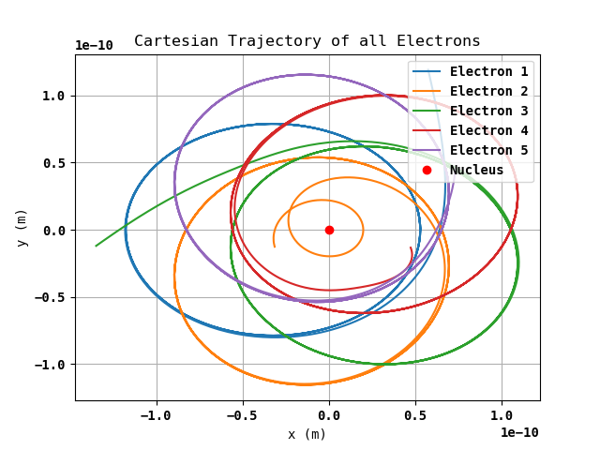
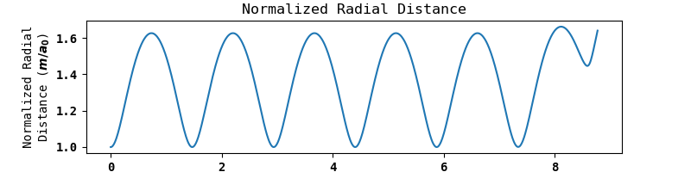
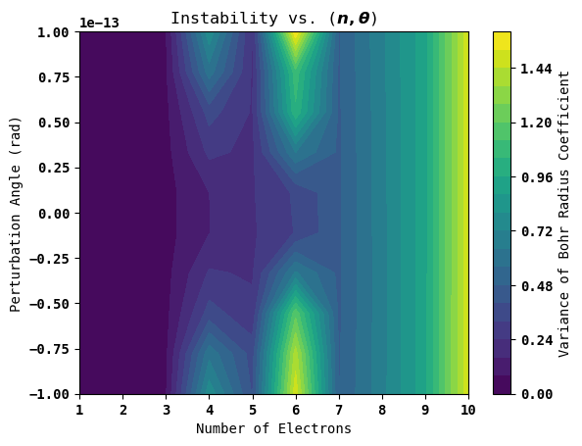
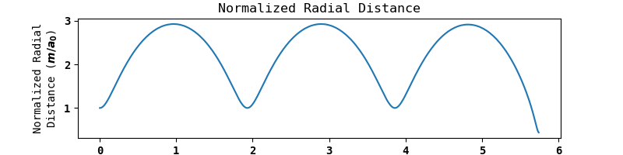
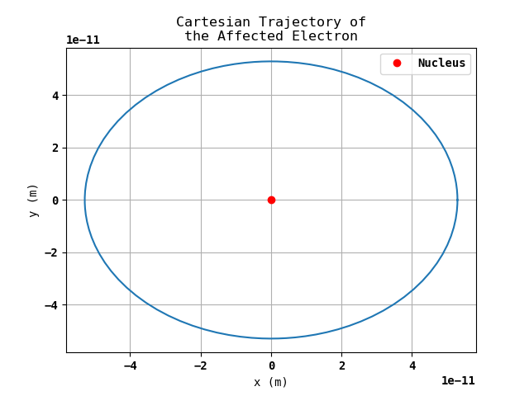
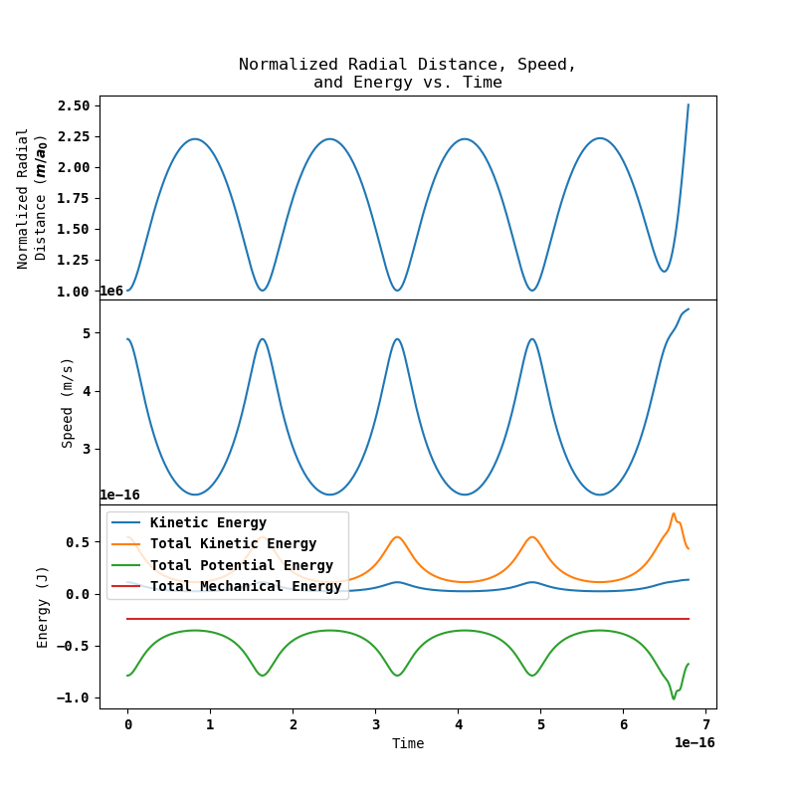
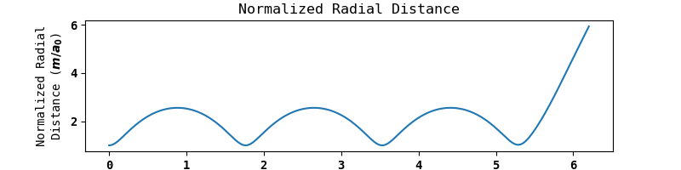
The University of British Columbia
Orbital Sensitivity to Angular Perturbation and Electron Count
Mufaro J. Machaya
Background/Questions
The most trivially stable orbital systems are radially symmetric (or geometric), such as 5 electrons being arranged in a pentagon, 6 in a hexagon, etc. What happens if one electron for a given system is rotated very slightly? Will the system remain perfectly stable?
As well, this assumes that all of the electrons are degenerate, so there are no considerations made to higher-order models where electrons have higher energy levels. Can a system of degenerate electrons arranged trivially be stable without using the Bohr model? What happens when it begins to deviate?
5 Electrons, 10^-14 Rad:
Phase Investigation
Instability is measured as the mean variance in the radial distance from the nucleus in Bohr radii units for all electrons in the system.
(1) The Edge of Stability (n=3, 10^-13 rad)
(2) Local Minima (n=5)
(3) Local Maxima (n=6)
Fig 2. Very slight, near zero perturbation still completely destabilized this system.
Conclusions
The model is completely stable for systems of 1 or 2 electrons regardless of perturbation (all return to stability completely) and breaks at 3 electrons (the first Bohr energy level).
The model is particularly unstable at specific types of geometry, like hexagons and squares.
Beyond 7 electrons, the system is fully unstable without regard to perturbation.
All systems have periodic, circular orbits up to a defining moment where stability is completely broken due to the system construction.
Stability can therefore be defined based on how long these orbits stay perfectly periodic/circular.
Fig 3. All behavior of the system was periodic up to a point at which the entire system completely breaks, so these systems are either completely stable or unstable.
Fig 1. The trivial case, with only one electron and no perturbation, is perfectly stable

